Slide 1

Movie
Xplorer

Slide 2
Timeline
Why are we here?
What can we say about the data using visualisation?
The application
INTRODUCTION
GOAL
DATA INSIGHTS
IMPLEMENTATION
DEMO
What are we trying to solve?
How built the solution?

Slide 3

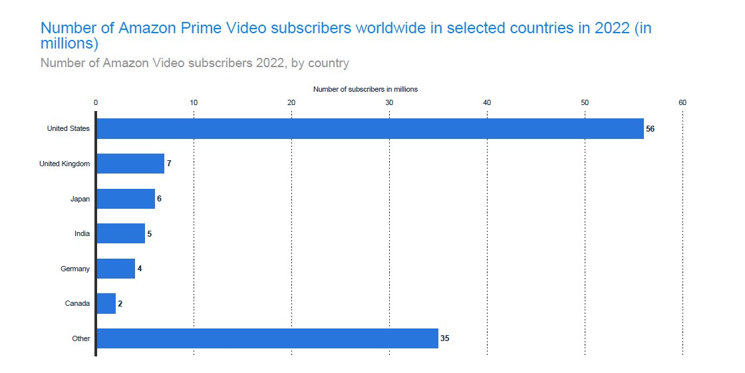
Amazon Prime Video

Slide 4
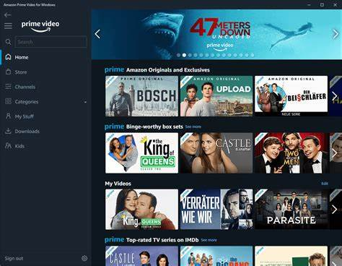

3 Reasons People leave Streaming services
Content not enough
Lack of good recommendations
Inconvenience

Slide 5



Goal
Real time movie recommendations based on user's historical preferences
More personalized recommendation promoting customer retention and conveniency
Increase in subscribers

Slide 6
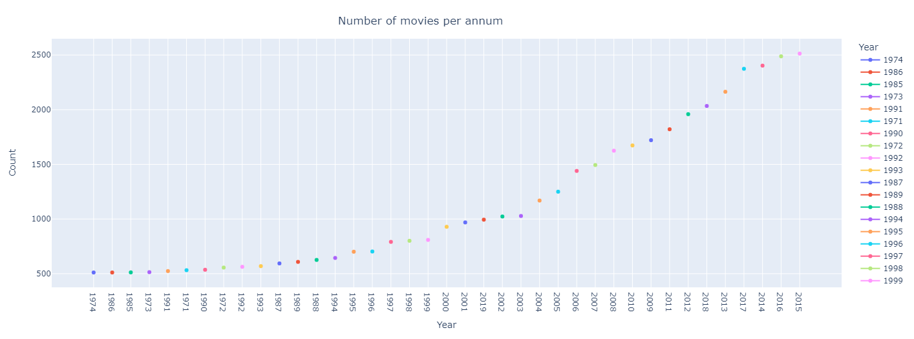
Data Insights
Movies Chart
Increasing number of Movies can potentially increase subscribers' retention
Attract new subscribers

Slide 7
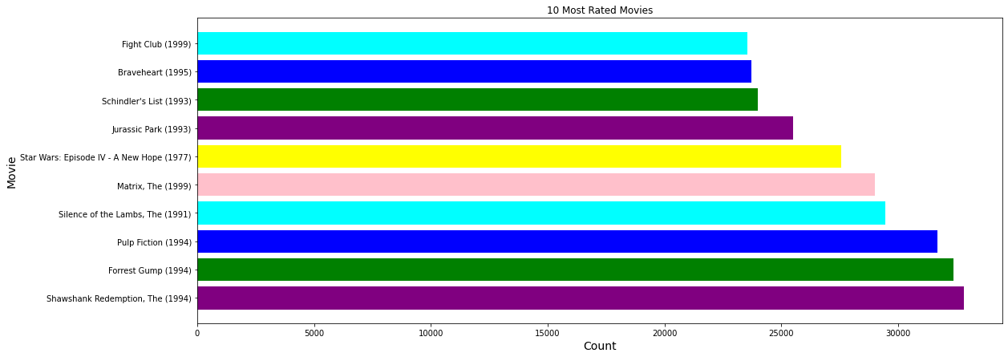
Most Rated Movies Bar Chart

Slide 8
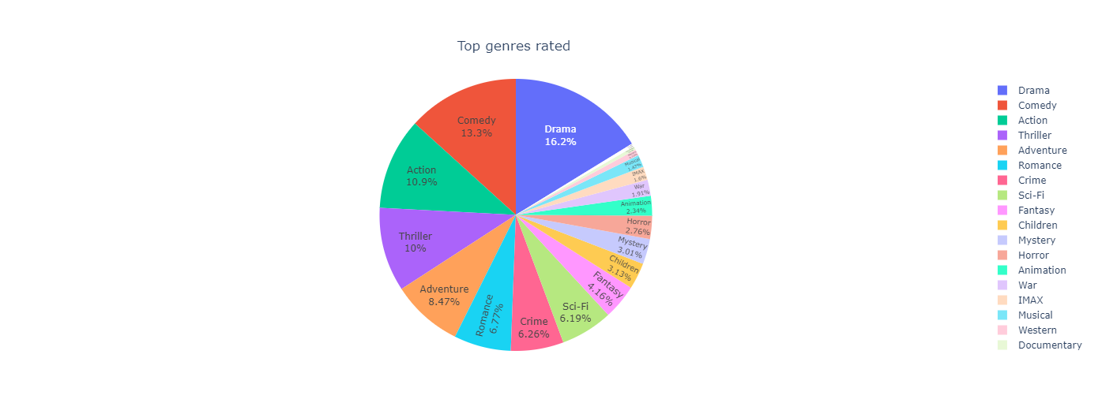

Genres Pie Chart
Increasing streaming content based on most rated genre

Slide 9

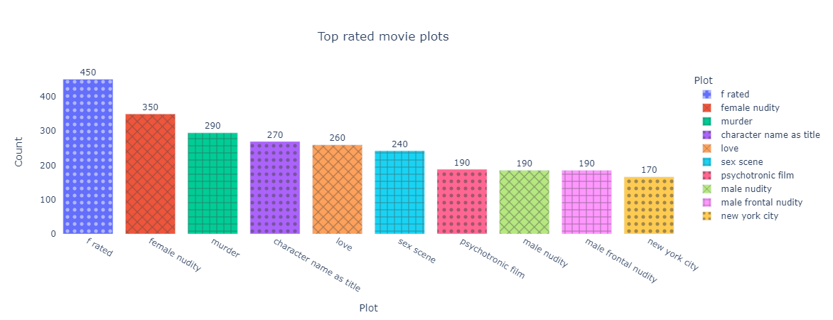
Top Rated Movie Plots
SN18+ plots most watched : subscribers love watching this kind of content.

Slide 10
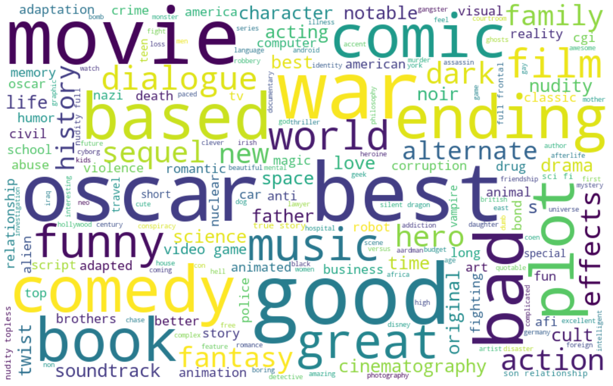
Keywords Word Cloud

Slide 11
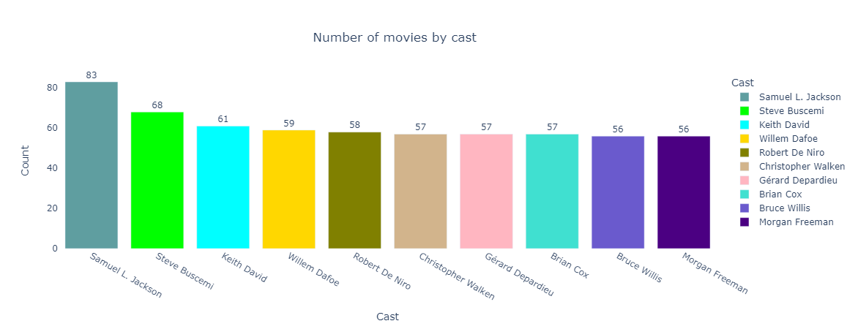
Most Occurring Cast Bar Chart
Most subscribers have favorite casts
Having a top 10 casts feature in the app

Slide 12
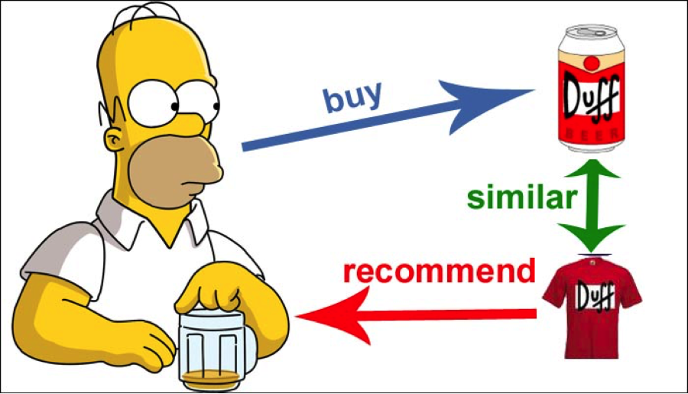
Building the Recommender Engine
Content-Based Filtering

Slide 13
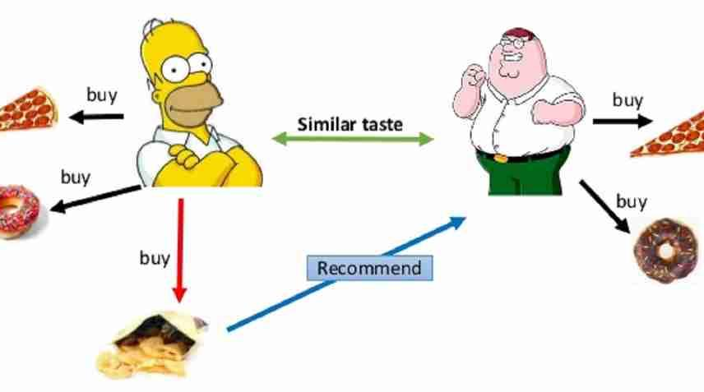
Building the Recommender Engine
Collaborative -Based Filtering

Slide 14
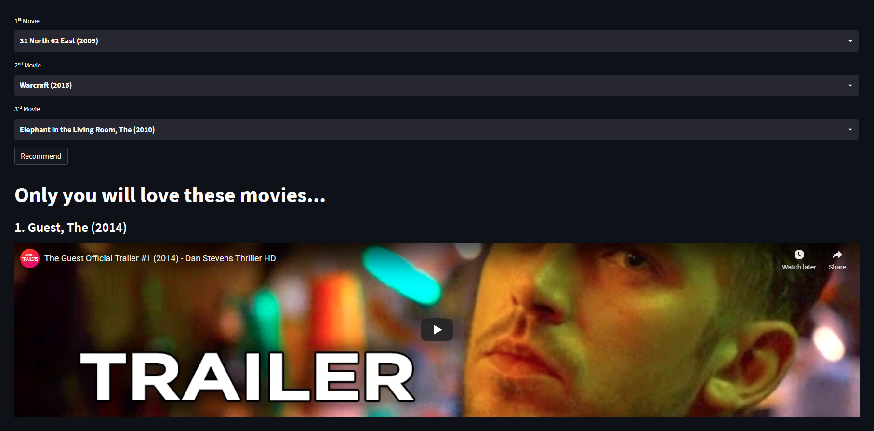
Movie Xplorer Demo
Featuring:
Recommender
Info
Trailers & Comment
Data Insights
Contact Info
Help Tutorials

Slide 15

Consolidated Amazon App
Idea Generation
Amazon Prime Membership:
Prime Video
Prime Gaming
Prime Music
Prime Reading
Concept Development
Pilot Phase

Slide 16


Competitive Advantages
Increasing content
Incorporating such algorithm as a cross recommendation system for Amazon
More accurate and personalized recommendations
increase in subscribers = increase in revenue
Top notch recommender against competing streaming providers

Slide 17

Thank You

Slide 18







Meet the Team
Trends Analytics Dream Team
Riaan James-Verwey
Elelwani
Tshikovhi
Siyanda
Madlopha
Thulani
Nyama
Reshoketswe
Makgamatha
Alna Schutte
Data Scientist
Data Scientist
Data Scientist
Data Analyst
Data Scientist
Data Analyst

Slide 19

Q & A

Slide 20
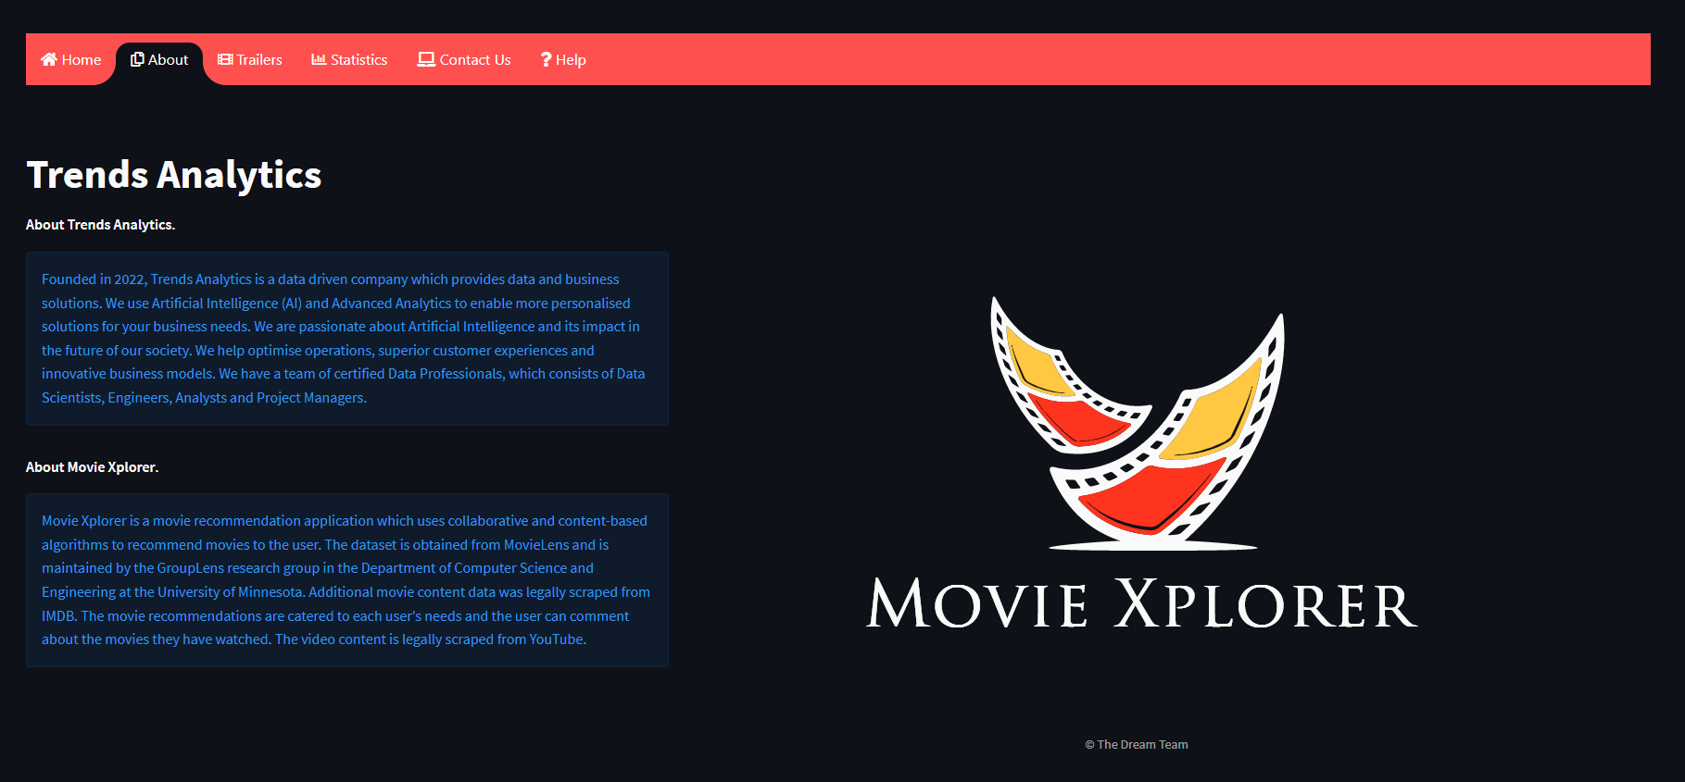
About
Knowledge is power.

Slide 21
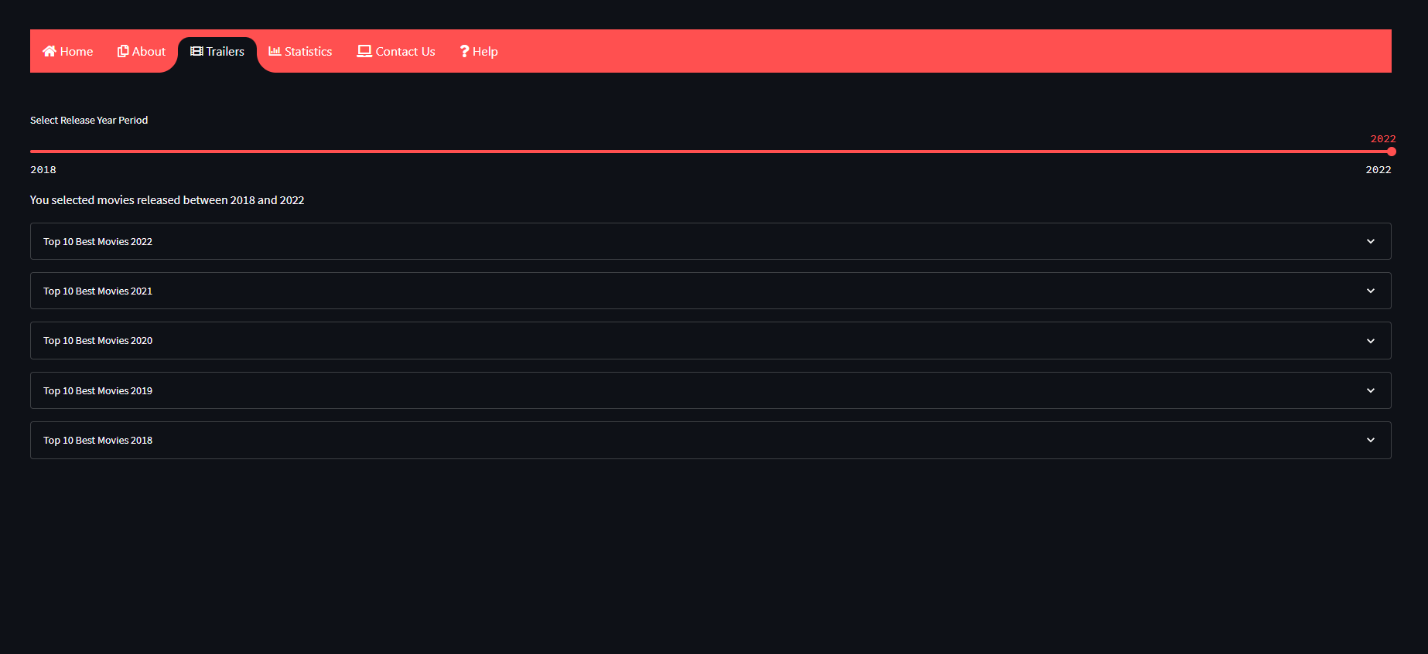
Trailers
Try it before you buy it.

Slide 22
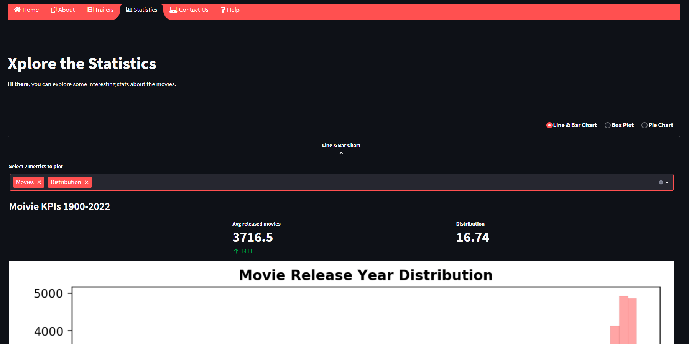
Statistics

Slide 23
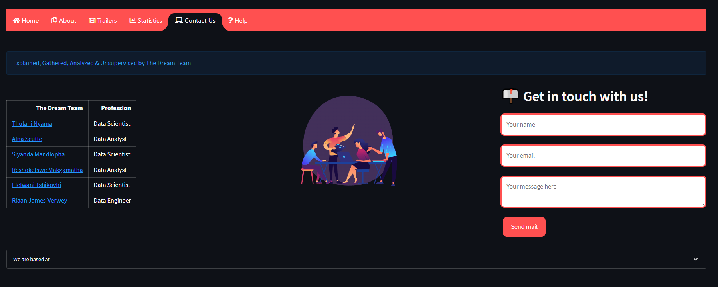
Contact Us
Reach out

Slide 24
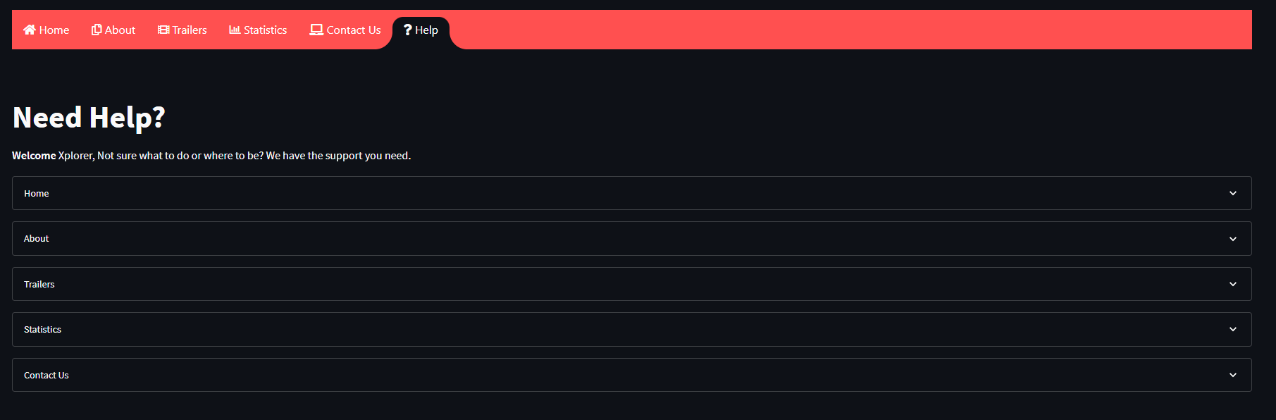
Help
Guides to all pages

